Slide 1

Logging UiPath Academy
The play by play of how your automation imploded

Slide 2
Logging
Practice wherein certain events during a program runtime is recorded​
Useful in finding points of failure, i.e, debugging
You log events in UiPath using the Log Message activity

Slide 3
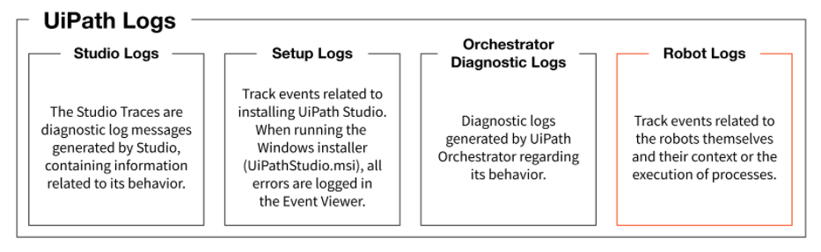
Types of Logs

Slide 4
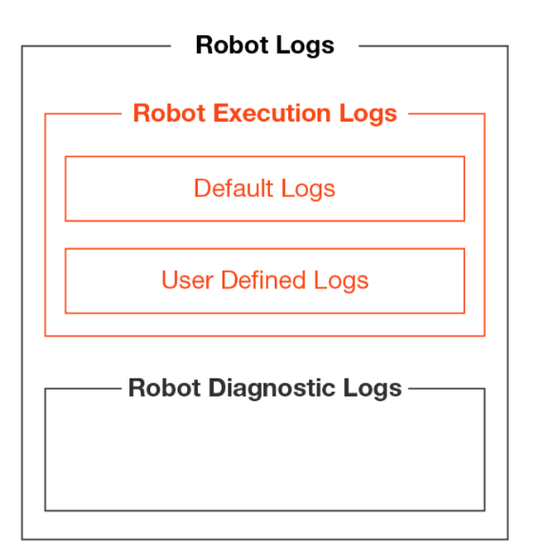
Robot Execution Logs Types of Logs | Robot Logs
Default logs are generated automatically when certain events take place.
Ex: Execution start/end, Transaction start/end
User-defined logs are generated according to the process designed by the user in Studio, when using the Log Message activity or by the Write Line activity.

Slide 5
Logging Levels Logging Levels
Fatal - Something has gone critically wrong and the process needs to be stopped
Error - An error occurred. The robot will attempt to recover and move on with the next item.
Warn - Any important data that we need to stand out from the rest of the log information.
Info - Information about robot progress.
Trace
Debugging/Verbose

Slide 6
Accessing Logs
Ouput Panel
%localappdata%\UiPath\Logs\ folder in your machine
Logs section in orchestrator

Slide 7
Anatomy of a log entry
Message: The Log Message
Level: Defines the log severity
Timestamp: The exact date and time the action was performed
FileName: The name of the .xaml file being “executed"
JobId: The key of the job running the process
ProcessName: The name of the process that triggered the logging
ProcessVersion: The version number of the process
WindowsIdentity: The name of the user that performed the action that was logged
RobotName: The name of the robot (defined in Orchestrator)

Slide 8
Logging best practices
At the beginning and the end of every workflow (Log level = Information).
Each time an exception is caught in a Catch block (Log level = Error).
Each time a Business Rule Exception is thrown (Log Level = Error).
When data is read from external sources, for example, log a message at Information level when an Excel file is read (Log Level = Information).
In Parallel or Pick activities, log messages on every branch, in order to trace the branch is taken (Log Level = Information).
In If/Flowchart Decision/Switch/Flow Switch activities (however, since processes might have a lot of these activities, we can decrease the Log Level from Information to Trace, so we don't have a lot of these logs in the database).

Slide 9

Questions?
Comments? Concerns? Violent Reactions?

Slide 10
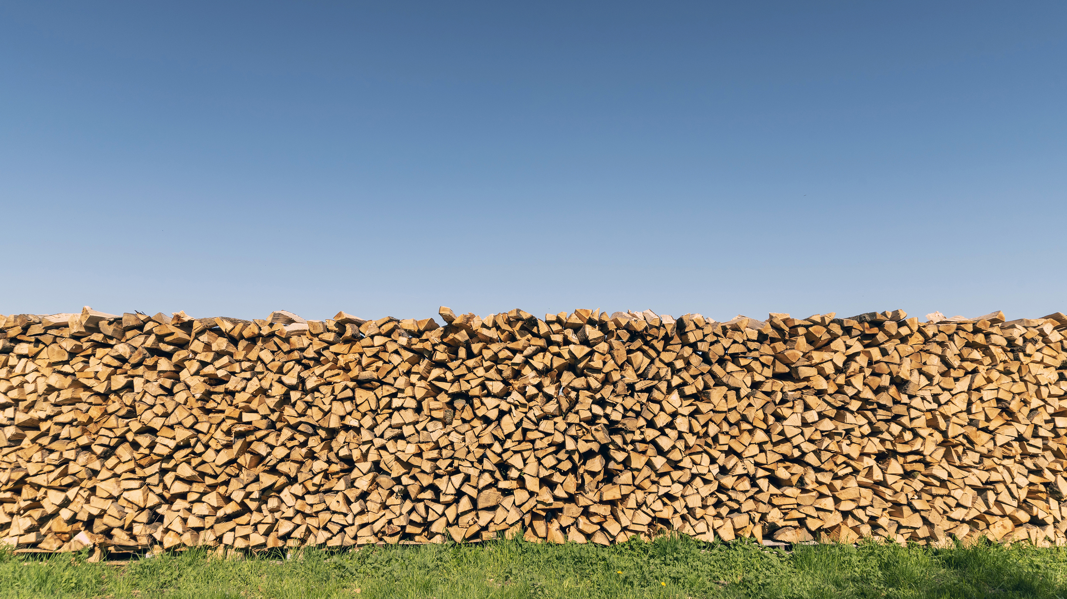
Discussion Questions
What is logging?
Why log?
What are the different logging levels?
What the different types of robot logs?
What are some logging best practices?

